Slide 1

SOFTWARE ENGINEERING
Week 7
Software Architecture and High Level Design

Slide 2
Agenda
Architectural Design of Software
Architecture Models

Slide 3

Architectural Design of Software
Architectural Design of Software
Architecture Models

Slide 4
Software architecture
The design process for identifying the sub-systems making up a system and the framework for sub-system control and communication is architectural design.
The output of this design process is a description of the software architecture.

Slide 5
Architectural design
An early stage of the system design process.
Represents the link between specification and design processes.
Often carried out in parallel with some specification activities.
It involves identifying major system components and their communications.

Slide 6
Advantages of explicit architecture
Stakeholder communication
Architecture may be used as a focus of discussion by system stakeholders.
System analysis
Means that analysis of whether the system can meet its non-functional requirements is possible.
Large-scale reuse
The architecture may be reusable across a range of systems.

Slide 7
Architecture and system characteristics
Performance
Localize critical operations and minimize communications. Use large rather than fine-grain components.
Security
Use a layered architecture with critical assets in the inner layers.
Safety
Localize safety-critical features in a small number of sub-systems.
Availability
Include redundant components and mechanisms for fault tolerance.
Maintainability
Use fine-grain, replaceable components.

Slide 8
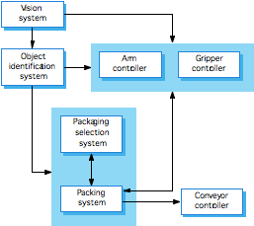
Packing robot control system

Slide 9
Box and line diagrams
Very abstract - they do not show the nature of component relationships nor the externally visible properties of the sub-systems.
However, useful for communication with stakeholders and for project planning.
Notes:
• Simple, informal block diagrams showing entities and relationships are the most frequently used method for documenting software architectures.
• But these have been criticised because they lack semantics, do not show the types of relationships between entities nor the visible properties of entities in the architecture.
• Depends on the use of architectural models.The requirements for model semantics depends on how the models are used

Slide 10
Architecture Models
Architectural Design of Software
Architecture Models
Notes:
Architectural design is a creative process so the process differs depending on the type of system being developed.
• However, a number of common decisions span all design processes and these decisions affect the non-functional characteristics of the system.

Slide 11
Architectural model decisions
Is there a generic application architecture that can be used?
How will the system be distributed?
What architectural styles are appropriate?
What approach will be used to structure the system?
How will the system be decomposed into modules?
What control strategy should be used?
How will the architectural design be evaluated?
How should the architecture be documented?

Slide 12
Architecture Models
Repository
Pipe and Filter
Event-driven / Asynchronous
Client Server
P2P
Layered
MVC
Service Oriented
Microservices

Slide 13
The repository model
Sub-systems must exchange data. This may be done in two ways:
Shared data is held in a central database or repository and may be accessed by all sub-systems: the repository model;
Each sub-system maintains its own database and passes data explicitly to other sub-systems.
When large amounts of data are to be shared, the repository model of sharing is most commonly used.
Notes:
All data in a system is managed in a central repository that is accessible to all system components. Components do not interact directly, only through the repository.

Slide 14
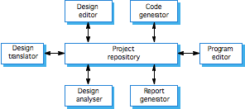
CASE toolset architecture
Notes:
A repository architecture for IDE

Slide 15
Repository model characteristics
Advantages
Efficient way to share large amounts of data;
Sub-systems need not be concerned with how data is produced;
Centralised management e.g. backup, security, etc.
Sharing model is published as the repository schema: easy integration;
Disadvantages
Sub-systems must agree on a repository data model. Inevitably a compromise;
Data evolution is difficult and expensive: e.g., changing the data model is expensive or even impossible;
No scope for specific management policies: sub-systems may have different requirements for security, backup, etc. …
Difficult to distribute efficiently.

Slide 16
Pipe and Filter model
This approach lays emphasis on the incremental transformation of data by successive component.
The connections between modules are represented as a data stream which is first-in/first-out buffer that can be stream of bytes, characters, or any other type of such kind
A filter is an independent data stream transformer or stream transducers. It transforms the data of the input data stream, processes it, and writes the transformed data stream over a pipe for the next filter to process.
Pipes are stateless and they carry binary or character stream which exist between two filters. It can move a data stream from one filter to another
Notes:
Functional transformations process their inputs to produce outputs.
May be referred to as a pipe and filter model (as in UNIX shell).
The processing of the data in a system is organized so that each processing component (filter) is discrete and carries out one type of data transformation. The data flows (as in a pipe) from one component to another for processing.

Slide 17
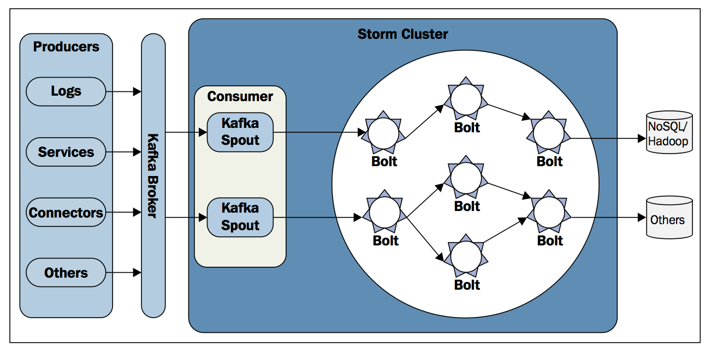
Apache Storm Architecture
Notes:
Spouts as data stream source tasks: connects to data sources such as a message queue as Kafka, gets continuous data, converts them into tuples and emits them to bolts
Bolts actual processing tasks

Slide 18
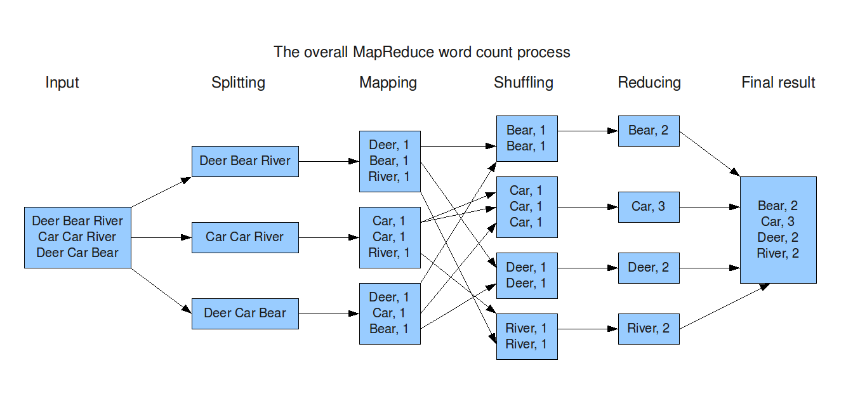
Map Reduce Architecture
Notes:
Hadoop has the same map reduce logic

Slide 19
Pipe and Filter model characteristics
Advantages
Provides concurrency and high throughput for excessive data processing.
Provides reusability and simplifies system maintenance.
Provides modifiability and low coupling between filters.
Provides simplicity by offering clear divisions between any two filters connected by pipe.
Provides flexibility by supporting both sequential and parallel execution.
Disadvantages
Not suitable for dynamic interactions.
A low common denominator is needed for transmission of data in ASCII formats.
Overhead of data transformation between filters.
Does not provide a way for filters to cooperatively interact to solve a problem.
Difficult to configure this architecture dynamically.

Slide 20
Event-driven / Asynchronous model
The event-driven architecture is made up of highly decoupled, single-purpose event processing components that asynchronously receive and process events.
The event-driven architecture pattern consists of two main topologies, the mediator and the broker.
The mediator topology is commonly used when you need to orchestrate multiple steps within an event through a central mediator
The broker topology is used when you want to chain events together without the use of a central mediator.
Notes:
Mediator roles: a single event to place a stock trade might require you to first validate the trade, then check the compliance of that stock trade against various compliance rules, assign the trade to a broker, calculate the commission, and finally place the trade with that broker.

Slide 21
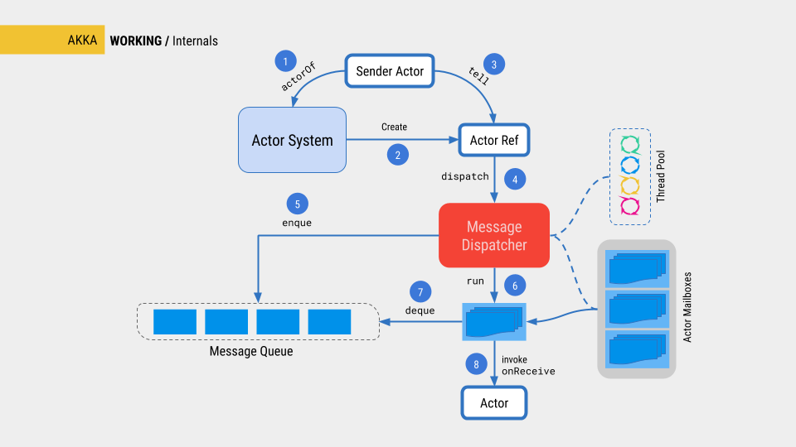
Akka architecture
Notes:
Akka: a set of open-source libraries for designing scalable, resilient systems that span processor cores and networks. Akka allows you to focus on meeting business needs instead of writing low-level code to provide reliable behavior, fault tolerance, and high performance.

Slide 22
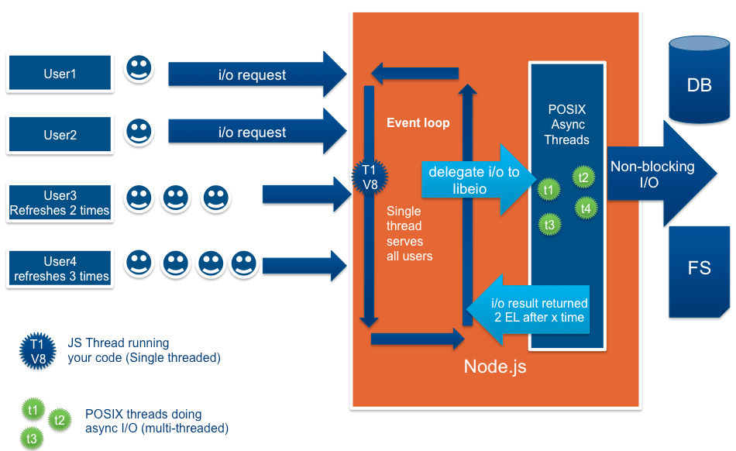
Node.js architecture
Notes:
Node.js: Open source, cross-platform Javascript runtime enviroment for executing JS code server-side.

Slide 23
Event-driven model characteristics
Advantages
Relatively easy to deploy due to the decoupled nature of the event-processor components
The pattern achieves high performance through its asynchronous capabilities
Scalability is naturally achieved in this pattern through highly independent and decoupled event processors.
Disadvantages
While individual unit testing is not overly difficult, it does require some sort of specialized testing client or testing tool to generate events.
Development can be somewhat complicated due to the asynchronous nature of the pattern as well as contract creation and the need for more advanced error handling

Slide 24
Client-server model
Distributed system model which shows how data and processing is distributed across a range of components.
Set of stand-alone servers which provide specific services such as printing, data management, etc.
Set of clients which call on these services.
Network which allows clients to access servers.
Notes:
In a client–server architecture, the functionality of the system is organized into services, with each service delivered from a separate server. Clients are users of these services and access servers to make use of them.

Slide 25
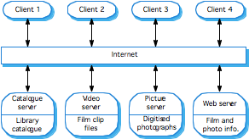
Film and picture library

Slide 26
Client-server characteristics
Advantages
Distribution of data is straightforward;
Makes effective use of networked systems. May require cheaper hardware;
Easy to add new servers or upgrade existing servers.
Disadvantages
No shared data model so sub-systems use different data organisation. Data interchange may be inefficient;
Redundant management in each server;
No central register of names and services - it may be hard to find out what servers and services are available.

Slide 27
Peer-to-peer model
Peers may function both as a client, requesting services from other peers, and as a server, providing services to other peers.
Peers acting as a server may inform peers acting as a client of certain events. Multiple clients may have to be informed, for instance using an event-bus.
When a peer receives a query, first the query is evaluated against its local data collection and thereafter, if necessary other peers are contacted through its neighbors. Query messages are forwarded only between open connections, i.e., neighboring peers.

Slide 28
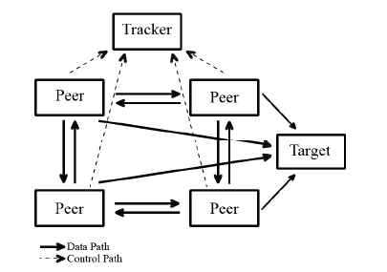
Bittorrent
Notes:
Blockchain also works as peer to peer.

Slide 29
Peer to peer characteristics
Advantages
Nodes may use the capacity of the whole, while bringing in only their own capacity.
Administrative overhead is low, because peer-to-peer networks are self-organizing
Scalable, and resilient to failure of individual peers.
The configuration of a system may change dynamically: peers may come and go while the system is running
Disadvantages
There is no guarantee about quality of service, as nodes cooperate voluntarily.
Security is difficult to guarantee
Performance may be low when there are few nodes

Slide 30
Layered model
Used to model the interfacing of sub-systems.
Organises the system into a set of layers (or abstract machines: tier) each of which provide a set of services.
Supports the incremental development of sub-systems in different layers. When a layer interface changes, only the adjacent layer is affected.
However, often artificial to structure systems in this way.
Notes:
Organizes the system into layers with related functionality associated with each layer. A layer provides services to the layer above it so the lowest-level layers represent core services that are likely to be used throughout the system.

Slide 31
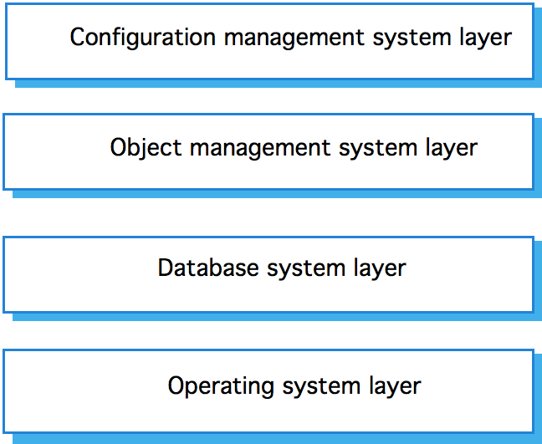
Version management system

Slide 32
Model View Controller
Architectural Pattern from Smalltalk (1979)
Decouples data and presentation
Eases the development

Slide 33
Model View Controller
Tier 1: View (Client)
Tier 2: Controller
Tier 3: Model (Logic/Database)
Notes:
Separates presentation and interaction from the system data. The system is structured into three logical components that interact with each other. The
Model component manages the system data and associated operations on that data. The View component defines and manages how the data is presented to the user. The Controller component manages user interaction (e.g. Key presses, Mouse clicks, etc.) and passes these interactions to the View and the Model.

Slide 34
Presentation
Database
Data
Presentation:
View is the user interface (e.g. button)
Controller is the code (e.g. callback for button)
Data:
Model is the database

Slide 35
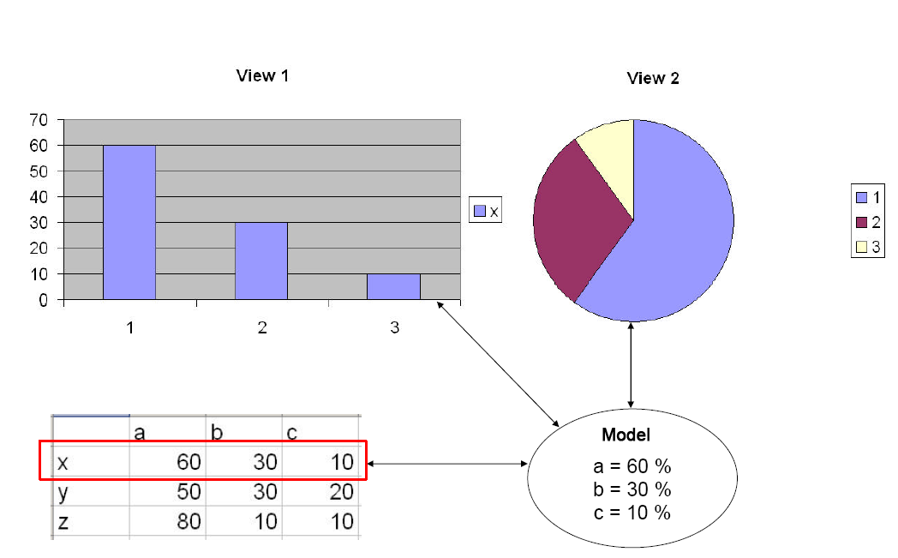
Example MVC

Slide 38
MVC
Advantages
Multiple views synchronized with same data model.
Easy to plug-in new or replace interface views.
Used for application development where graphics expertise professionals, programming professionals, and data base development professionals are working in a designed project team.
Disadvantages
Not suitable for agent-oriented applications such as interactive mobile and robotics applications.
Multiple pairs of controllers and views based on the same data model make any data model change expensive.
The division between the View and the Controller is not clear in some cases.

Slide 39
SOA model
A service-oriented architecture provides the following features
Distributed Deployment: Expose enterprise data and business logic as loosely coupled, discoverable, structured, standard-based, coarse-grained, stateless units of functionality called services.
Composability: Assemble new processes from existing services that are exposed at a desired granularity through well defined, published, and standard compliant interfaces.
Interoperability: Share capabilities and reuse shared services across a network irrespective of underlying protocols or implementation technology.
Reusability: Choose a service provider and access to existing resources exposed as services.

Slide 40
SOA
Advantages
Great flexibility for enterprises to make use of all available service resources irrespective of platform and technology restrictions.
Each service component is independent from other services due to the stateless service feature.
Easy to implement a service with the exposed interface
Easy to access a service regardless of their platform, technology, vendors, or language implementations.
Reusability of assets and services since clients of a service only need to know its public interfaces, service composition.
SOA based business application development are much more efficient in terms of time and cost.
Enhances the scalability and provide standard connection between systems.
Efficient and effective usage of ‘Business Services’.
Integration becomes much easier and improved intrinsic interoperability.
Abstract complexity for developers and energize business processes closer to end users.
Disadvantages
Costly due to abstraction and better design
Extra overload to validate every input prior to sending to the service
Bandwidth for service communication

Slide 41
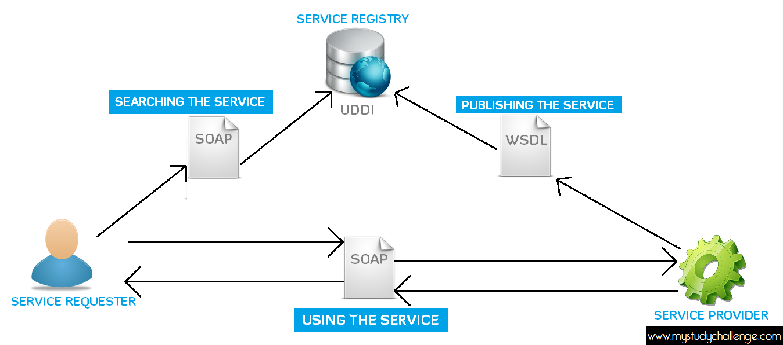
Web Services
Example SOA: A website using payment service like PayPal integration

Slide 42
Microservice model
Each component of the microservices architecture is deployed as a separate unit
Service components contain one or more modules (e.g., Java classes) that represent either a single-purpose function (e.g., providing the weather for a specific city or town) or an independent portion of a large business application (e.g., stock trade placement or determining auto-insurance rates)
All the components within the architecture are fully decoupled from one other and accessed through some sort of remote access protocol (e.g. REST)

Slide 43
REST Architecture

Slide 44
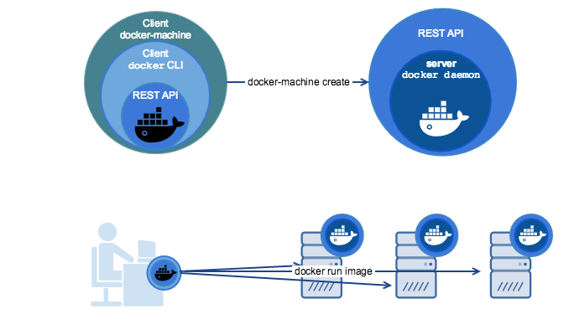
REST through Docker

Slide 45
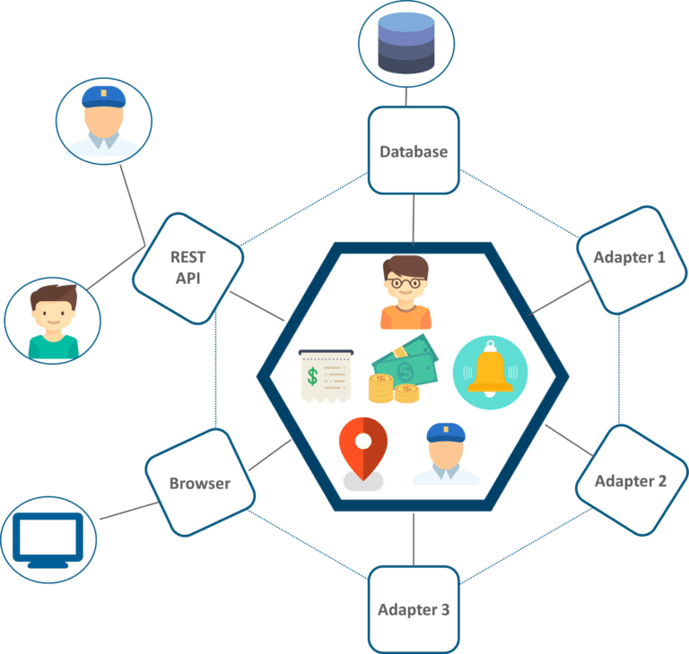
UBER’s Monolithic Architecture (Before)
Communication between passenger and customer is via REST API
Adapters for billing, payment, sending messages, trip management
https://medium.com/edureka/microservice-architecture-5e7f056b90f1

Slide 46
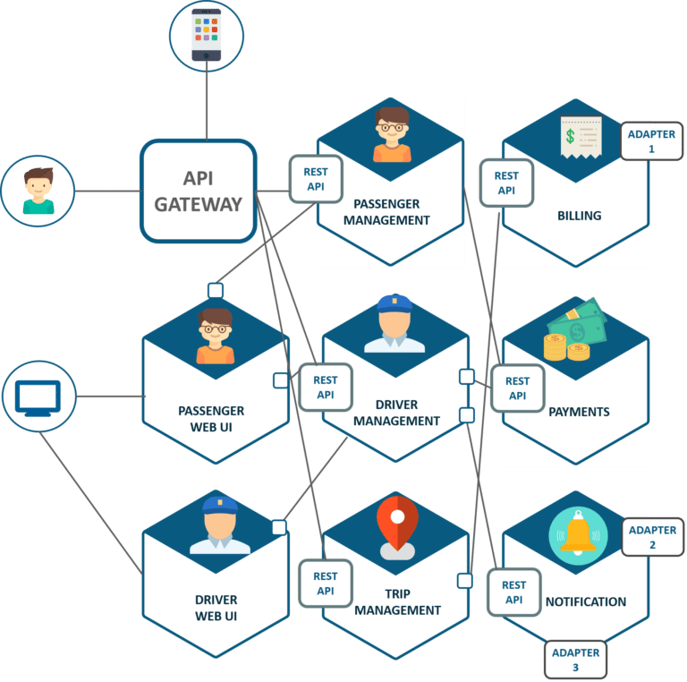
UBER’s Microservice Architecture (After)
Notes:
The major change that we observe here is the introduction of API Gateway through which all the drivers and passengers are connected. From the API Gateway, all the internal points are connected such as passenger management, driver management, trip management, and others.
The units are individual separate deployable units performing separate functionalities.
For Example: If you want to change anything in the billing Microservices, then you just have to deploy only billing Microservices and don’t have to deploy the others.
All the features were now scaled individually i.e. The interdependency between each and every feature was removed.
For Example, we all know that the number of people searching for cabs is more comparatively more than the people actually booking a cab and making payments. This gets us an inference that the number of processes working on the passenger management microservice is more than the number of processes working on payments.

Slide 47
Microservice characteristics
Advantages
Overall this pattern is relatively easy to deploy due to the decoupled nature of the event-processor components.
Due to the separation and isolation of business functionality into independent applications, testing can be scoped, allowing for more targeted testing efforts
Because the application is split into separately deployed units, each service component can be individually scaled, allowing for fine-tuned scaling of the application
Disadvantages
This pattern does not naturally lend itself to high-performance applications due to the distributed nature of the microservices architecture pattern
Increased troubleshooting
Increased effort for configuration
Transaction safety
Tracking data through services is difficult

Slide 48
Wrap-up
This week we present
Architectural Models
Different architectural models may be produced during the design process
Each model presents different perspectives on the architecture

Slide 49
Next Week
We will be covering Software Design Engineering!!!

